Slide 1
What is filtering and why might I need it?
Practical Course: Introduction to Electroencephalography
by Matthias Ertl
Presentation by Laura Leuchs
26.11.2015

Slide 2
What is filtering?
Notes:
For the first question we need to
Get away from EEG analysis in the time domain
Like looking at event related potentials
And understand EEG data as oscillations

Slide 3
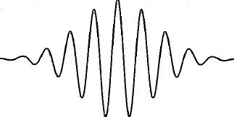
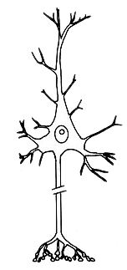








Oscillations
Cortex
Thousands to millions of neurons firing synchronously
Notes:
With EEG we basically measure the snchronous
Activity of neurons
We can measure neuronal activity neurons are dipoles
And when they fire they change polarity and
Cause tiny current flows
We can only measure these tiny currents on the top of the scalp
If thousands to millions of neurons
Fire in parallel and their effect sums up
Then what we record are oscillations

Slide 4
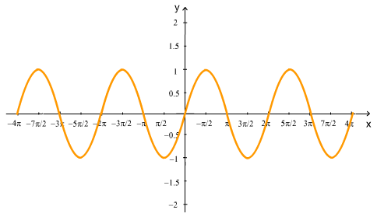
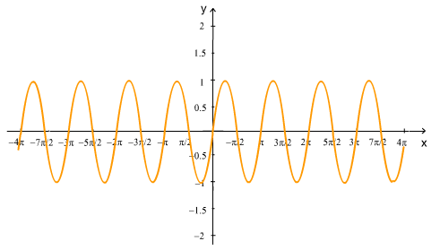
Oscillations
EEG amplitude:
0 - 200 µV on scalp
Frequency:
0.5-50 Hz (maybe up to 100Hz)
(guidelines adapted from Schandry, 2006)
Notes:
Oscillations in general have an amplitude
In EEG the amplitude depends on how many neurons fire
In synchronized manner
And how close they are to the scalp
In scalp EEG we can measure up to 200 microvolts
Furthermore oscillations have a certain frequency
Measured in Hz
Means how many of those cycles we measure
Per second
The neuronal firing synchronizes in a certain pattern
The typical range for these frequencies in scalp EEG
between 0.5 -50 Hz
Some people claim also higher ones are of interest

Slide 5
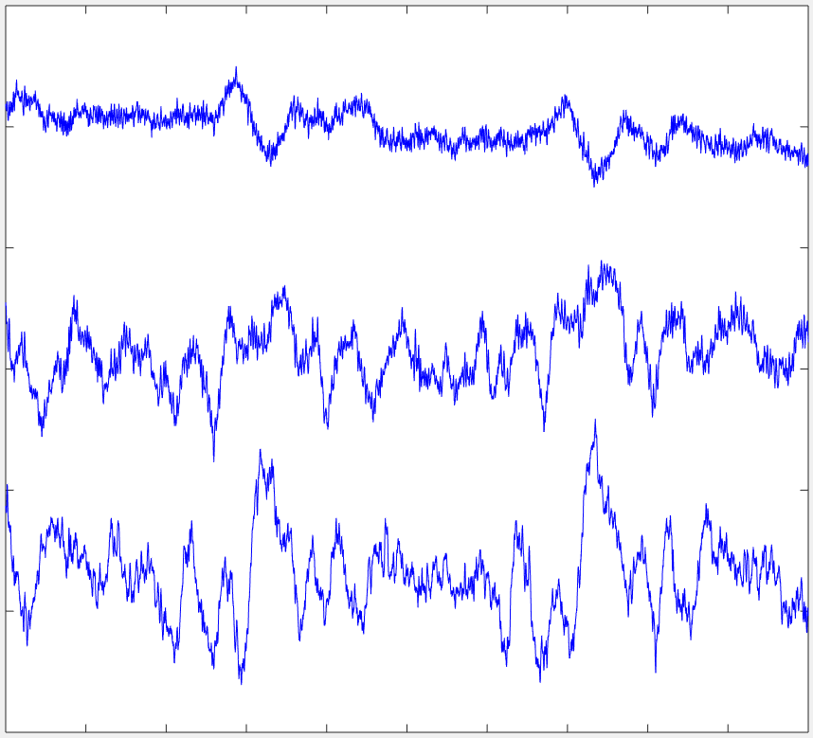
Raw EEG
P3
= 50µV
Fz
F3
1 | 2 | 3 | 4 | 5
sec
EEG Filtering, 26.11.2015, Laura Leuchs
Notes:
If you look at EEG data you have recordings from different sites
Here 3 electrodes
what we see is never just
One oscillation of one stable frequency and amplitude
But every channel contains a mix of a huge frequency spectrum
Overlying each other and summing up
To something like this
________________________________
To answer the initial question:
Filtering in EEG analysis means
to remove ceratin frequency bands
From the EEG data
That we are not in terested in

Slide 6
Ways to filter:
Filter online during measurement or offline afterwards
Low pass filter: remove high frequencies
High pass filter: remove low frequencies
Notch filter: remove artifacts in a specific frequency range
Inverse fourrier transform
Independent component analysis (ICA)
EEG Filtering, 26.11.2015, Laura Leuchs
Notes:
Low pass = high cot off
High pass= low cut off
Inverse fourier transf:
transform data from time to frequency form:
Disentangle it into the frequencies it is composed of
Take away the frequ we don‘t want
And transform it back into time domain
ICA similar principle: if there is a dominant frequency in the data
It might form one component that we can detect in ICA
Split data into ist components
Remove the one we don‘t want
Transform it back

Slide 7
Why might I need filtering?
Notes:
As I said EEG recordings contain lots of
Frequencies of diff amplitudes
Mixed and underlying dynamic changes
We are not interested in all of the frequencies
Why?

Slide 8
Why filter?
Frequencies below max. 50 Hz are of interest:
line noise from computers/ power supply: 50-60Hz
Muscle artifacts: over 50 Hz
Slow drifts below 1Hz are mostly artifacts:
linear trends evoked by sweating / slowly changing impedances
Breathing
Slow movements
Scanner artifacts from simultaneous EEG / fMRI
Cardiovascular artifacts
Eye blinks & movements
(guidelines adapted from Wellach, 2003 and Schandry, 2006)
Notes:
50Hz artifacts come from alternating current
For example power supplys
…
On top of these reasons I might want to
Take a look at a very specific frequency band
Like theta or gamma oscillations in the
Context of cognitive tasks

Slide 9
Some examples what happens to the data with filtering…
Notes:
As I said EEG recordings contain lots of
Frequencies of diff amplitudes
Mixed and underlying dynamic changes
We are not interested in all of the frequencies!

Slide 10
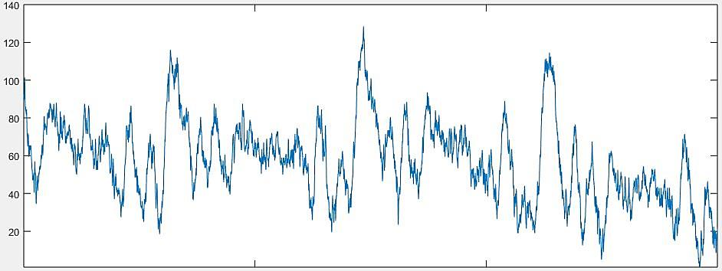
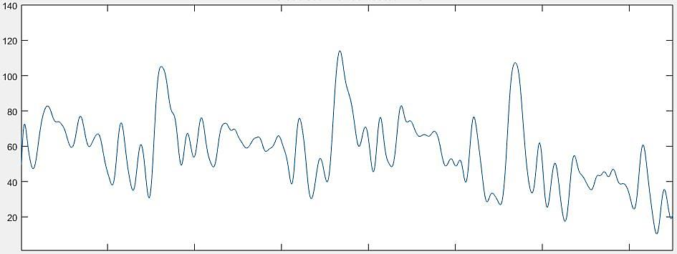
Low pass filtering: remove line noise / muscle artifacts (>50 Hz)
µV
sec
1 | 2 | 3 | 4
µV
sec
1 | 2 | 3 | 4
Notes:
If interested in higher frequencies:
Only use notch filter for 50 Hz to remove line noise
Or make sure there is none!

Slide 11
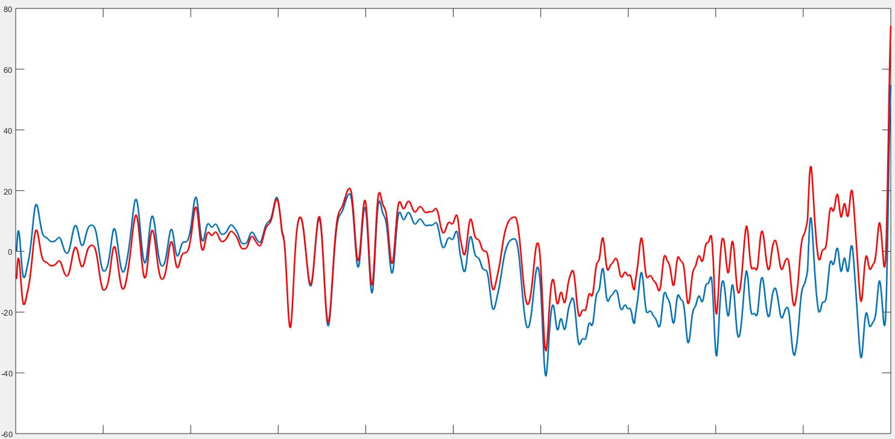
High pass filtering: remove slow drifts, detrend
µV
sec
1 | 2 | 3 | 4
EEG Filtering, 26.11.2015, Laura Leuchs
Notes:
If you are not interested in really low frequencies
If people sweat impedances change slowly over time
This slow drift has nothig to do with cognitive effects
Want to get rid of it

Slide 12
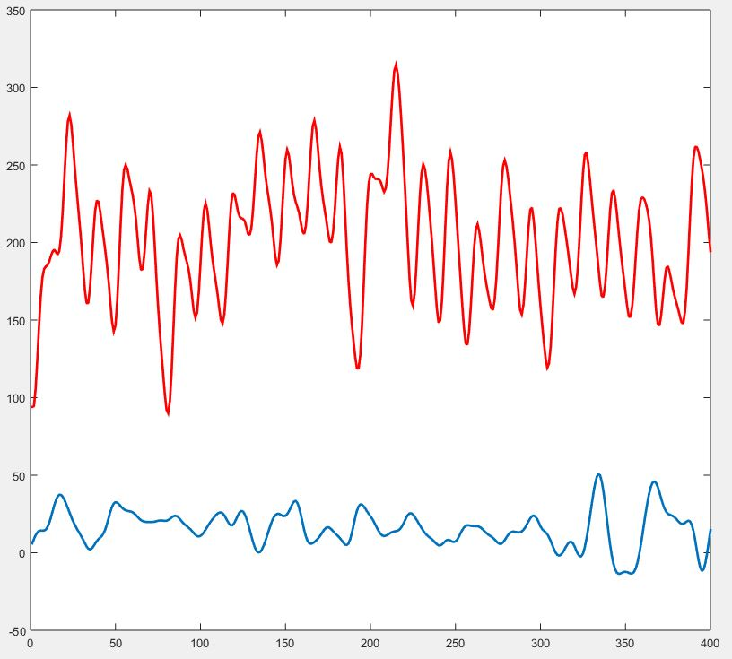
Inverse fourier transform
50µV
0.5 | 1 | 1.5
sec
50µV
0.5 | 1 | 1.5
sec
EEG Filtering, 26.11.2015, Laura Leuchs
Notes:
I won‘t go into detail
Just want to show the principle of fourier transform:
depicted two different segments of EEG data
Each dominated by different frequency
If you count you can see:
Strong rhythm of 12 waves per second = 12 Hz, alpha
Strong rhythm of about 6 cycles / sec = 6Hz, theta

Slide 13
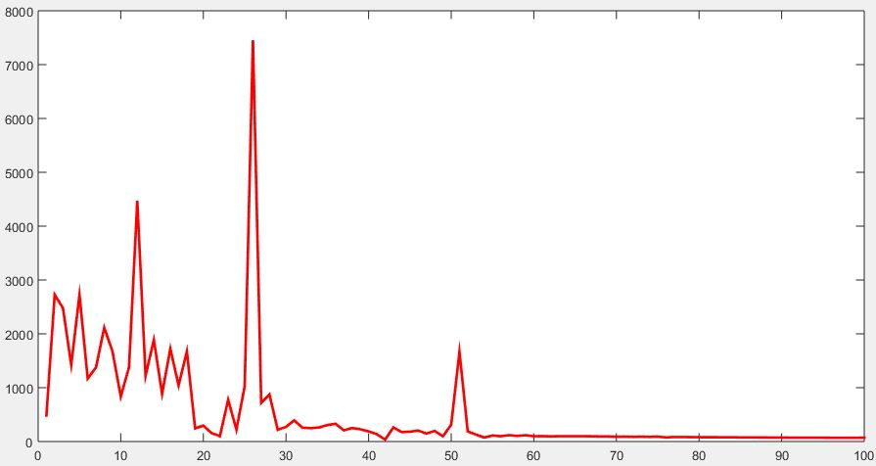
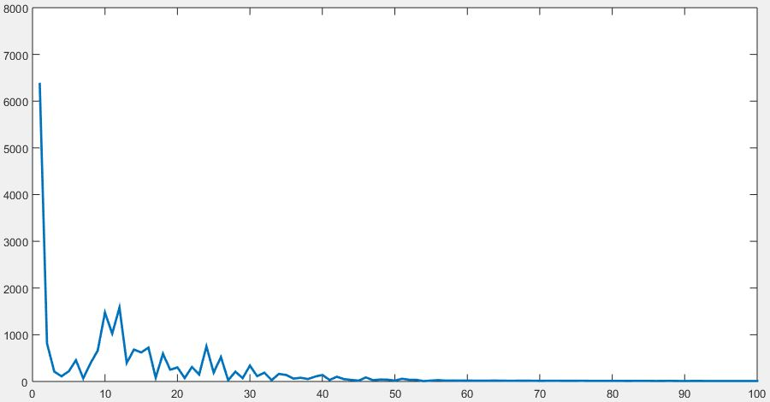
Inverse fourier transform
5 | 10 | 15 | 20 | 25 | 30 | 35
Hz
5 | 10 | 15 | 20 | 25 | 30 | 35
Hz
EEG Filtering, 26.11.2015, Laura Leuchs
Notes:
If you take these 2 seconds apart into
Their frequency spectra:
frequencies listed on x axis
And their power (how strongly they are represented in these 2 sec)
On the y axis
Obvious that we have a strong 12 Hz peak in first segment
Bit of a weaker peak around 6 Hz in 2nd segment
You could now exclude a certain frequency band
For example very low frequencies
and transform it back into time domain
-> you‘ll receive that 2 sec segment again

Slide 14
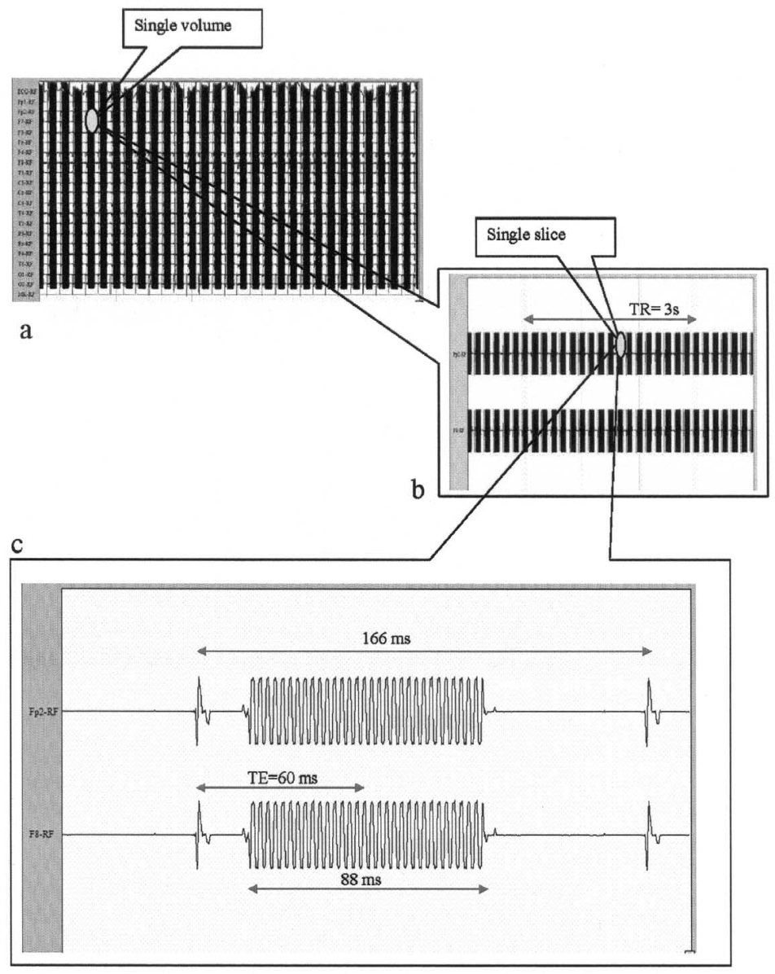
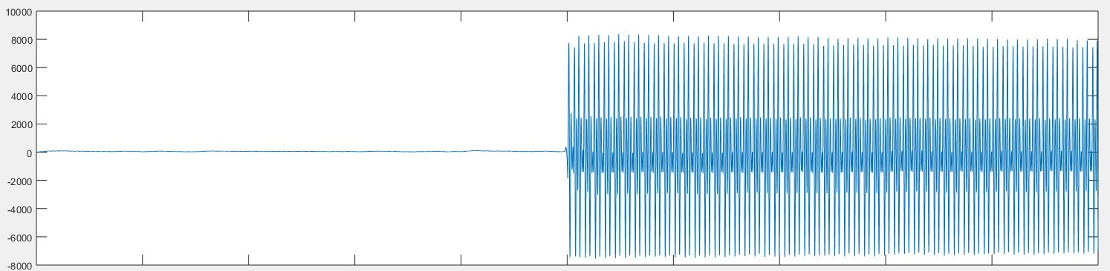
fMRI artifacts
Scanner artifacts: filtering depends on scanner pulse frequency
Figure from Gareffa el al., 2003: Single EPI slice artifact events on two EEG channels. TR 3s, 18 slices, 166 ms, TE 60 ms.
µV
1 | 2 | 3 | 4 | 5 | 6 | 7 | 8 | 9 | 10
sec
EEG Filtering, 26.11.2015, Laura Leuchs

Slide 15
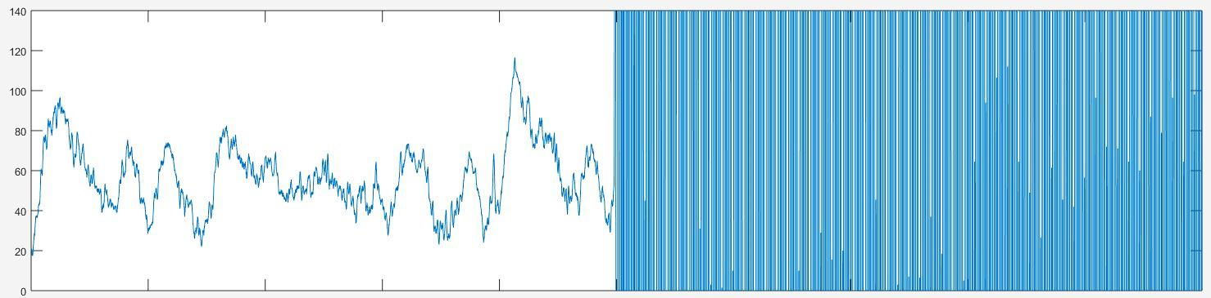
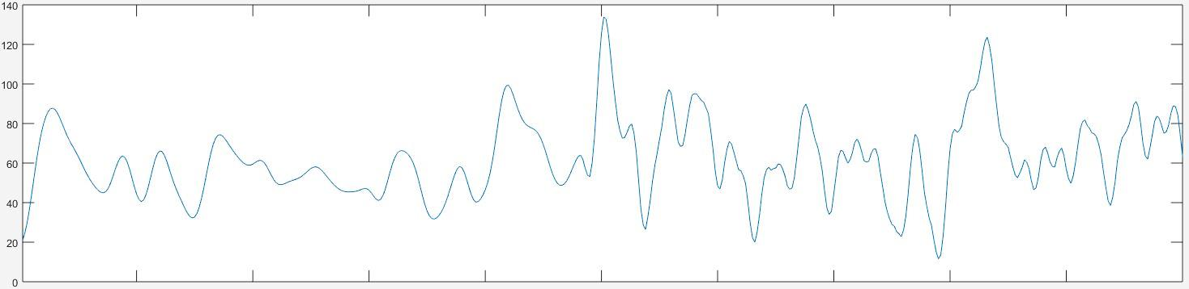
fMRI artifacts
µV
sec
1 | 2 | 3 | 4 | 5
µV
sec
1 | 2 | 3 | 4 | 5
EEG Filtering, 26.11.2015, Laura Leuchs
Notes:
Principle:
Need marker for each scanner pulse
Tell programm how many pulses make one volume
Build a template of how an average scanner pulse looks like
And subtract it from your data

Slide 16
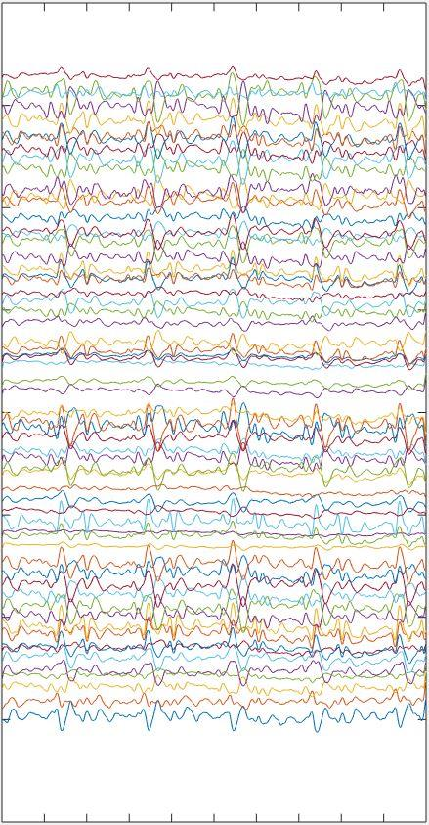
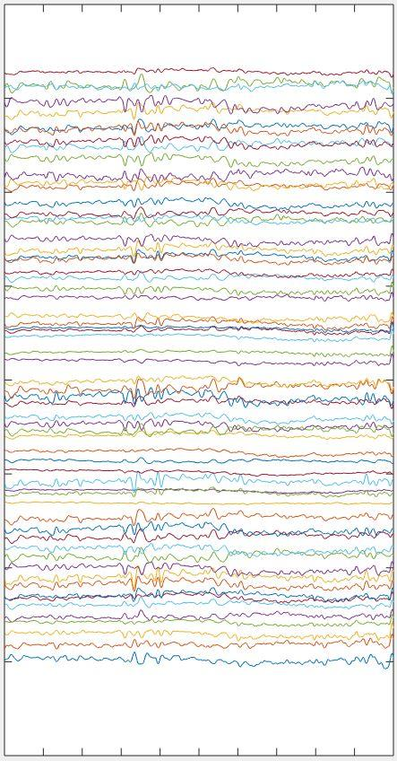
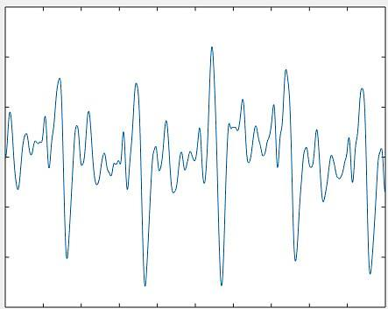
Cardiological artifacts
Extract & remove pulse (for example with ICA)
first component of PCA on all
64 channels:
sec
sec
sec
1 | 2 | 3 | 4
1 | 2 | 3 | 4
1 | 2 | 3 | 4
Notes:
After removing high and low frequency noise
You might still have a very dominant
regular rhythm in your data that comes from
Pulse
Programs have different kinds of algorhythms
Easiest way to do it yourself is probably to run
A component analysis

Slide 17
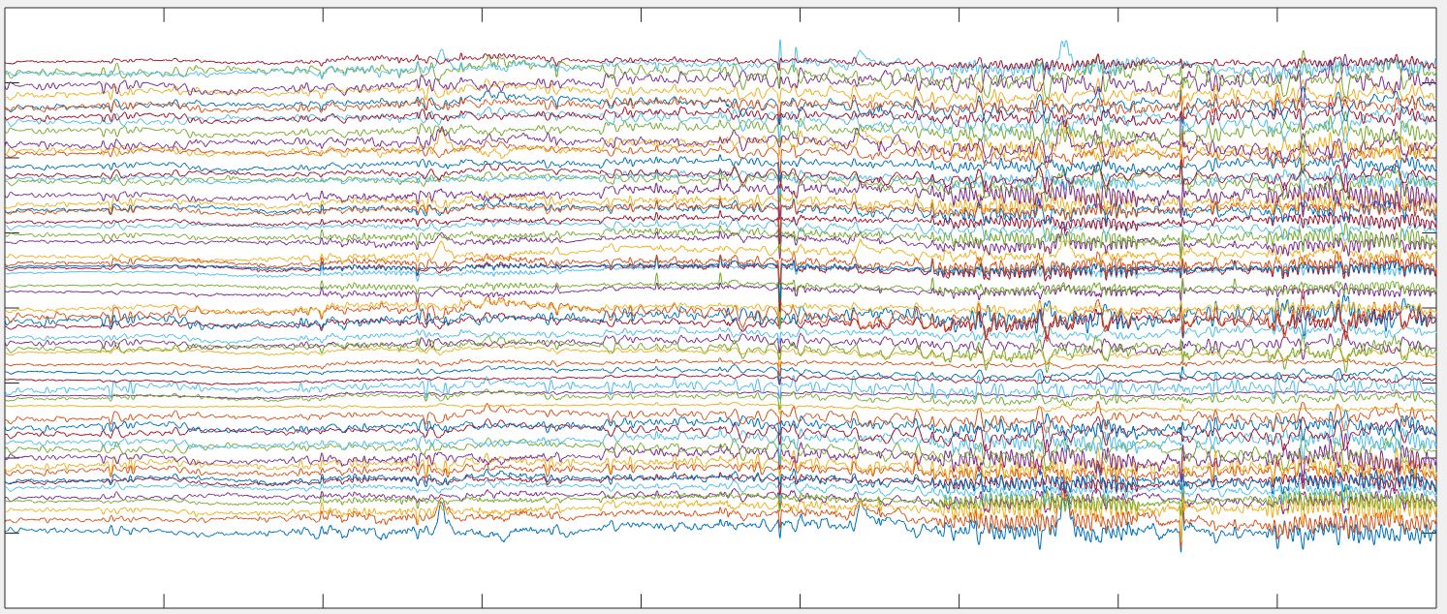
Eye blinks / movement artifacts
10 | 20 | 30 | 40 | 50 | 60 | 70 | 80 | 90
Notes:
The same way you might want to remove
High frequent noise or eye blinks by removing
A component with high frequencies

Slide 18
Filtering with matlab:
IIR: Digital infinite-duration impulse response filters; filters the data in both directions, avoiding shifts in the data
Matlab example >> butter(…)
FIR: Digital filters with finite-duration impulse response filters (“all-zero”-filters); Introduce more delay than IIR
Matlab example >> filtfilt(…)
Notch filter: define frequency band to be excluded individually
Matlab example >> designfilt('bandstopiir', ...)
Fourier transform: transfer time to frequency domain
Matlab example >> fft(...)
Component analysis: extract dominant components from your data
Matlab example >> princomp(...)
EEG Filtering, 26.11.2015, Laura Leuchs

Slide 19
Careful:
Filter before cutting the data if possible
Use filters that don’t introduce a shift in the data (best IIR)
EEG Filtering, 26.11.2015, Laura Leuchs

Slide 20
References
Garreffa G, Carnì M, Gualniera G, Ricci GB, Bozzao L et al. (2003). Real-time MRI artifacts filtering during continuous EEG/fMRI acquisition. Magnetic Resonance Imaging, 21, 1175–1189.
Schandry, R. (2006). Biologische Psychologie (2. überarb. Auflage). Weinheim: Beltz.
Wellach, I (2011). Praxisbuch EEG: Einführung in die Befundung, Beurteilung und Differenzialdiagnose. Stuttgart: Thieme.
EEGlab online Tutorial: http://sccn.ucsd.edu/eeglab/maintut/preprocessing_tools.htmlold
http://www.mathworks.com

